Slide 1
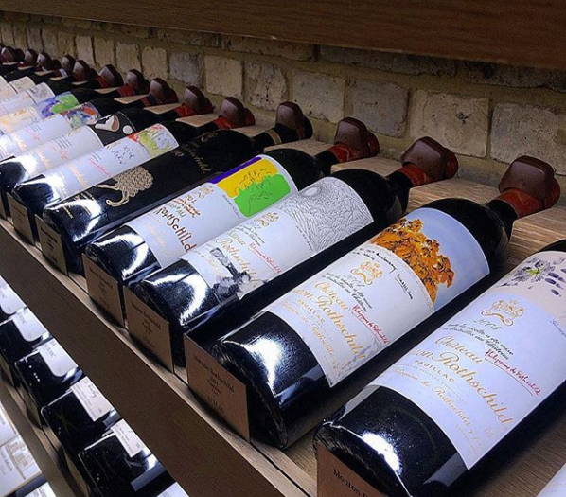
Melissa Morgan
Blake Skinner
Godwin Thomas
Julia Thompson
Rebekah Vinson

Slide 2
The Effect of Physicochemical on the Wine Quality

Slide 3
the vino, the grape, plonk, vin du pays, port, burgundy, vin de table, vin ordinaire, walla walla, splishy splashy, slap the belly
Why Wine?

Slide 4
when wine
goes in
wisdom
comes out
- It’s data science

Slide 5
the Data Dorks can help out the Cork Dorks

Slide 6
Project data

Slide 7
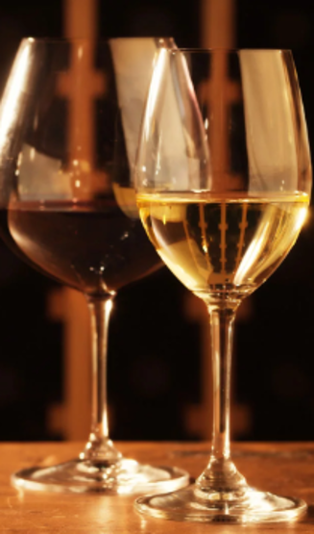
THE SOURCE
Paulo Cortez, University of Minho,
Guimarães, Portugal
THE DATA
Our two datasets include:
Sample set of approximately 1,600 red and 4,800 white wines
12 numerical attributes / features for each sample wine
OBJECTIVE
Develop a machine learning model using the chemical makeup of wine to predict its quality.

Slide 8
Data Attributes
Input variables (based on physicochemical tests):
1 - fixed acidity
2 - volatile acidity
3 - citric acid
4 - residual sugar
5 - chlorides
6 - free sulfur dioxide
7 - total sulfur dioxide
8 - density
9 - pH
10 - sulphates
11 - alcohol
Output variable (based on sensory data):
12 - quality (score between 0 and 10)

Slide 9
Machine Learning

Slide 10
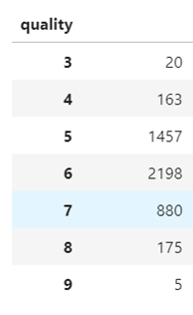
Data Exploration
Pulled in data
Separate csv files for red and white wine
Looked at the datatypes
All floats except for quality
Changed datatype to float for quality
Looked at data shape
Quality not evenly distributed amongst classifications
Skewed heavily to quality of 5 & 6
Understand that this is heavily going to affect our model

Slide 11
The Models
Model | Accuracy
RandomForestClassifier | 0.707142857
XGBoost | 0.66122449
DecisionTreeClassifier | 0.582653061
KNeighborsClassifier | 0.558035714
LogisticRegression | 0.481632653
NaivesBayes | 0.448341837
Created x and y variables
output (y) = quality
x = other features
Train test split from x and y variables
Ran multiple models to test and compare accuracies
linear regression r2 score = 0.281361

Slide 12
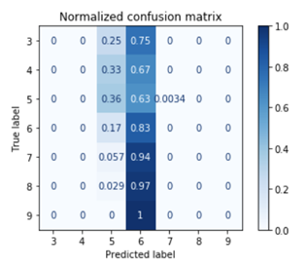
The Models Continued
Confusion matrix to see where there were inaccuracies - shows that model chose 6 far too often
Tried two different types of data scaling – feature scaling and PCA. Neither helped the shape of our data enough to impact our model.
Tried two different types of hypertuning to improve our accuracy. Randomized Search & GridSearch. When the optimal params from those searches were added to the model – accuracy decreased.
Used pickle to save our model down into a callable sav file

Slide 13
Live Demonstration

Slide 14
Project Final Materials & Demonstration
bc633.pythonanywhere.com
Project Link
Route to different html files using render_template.
Includes the home page, imbedded tableau visualization, and site for users to submit data and receive a prediction on wine quality.
The route doShit() retrieves the input from the user, and runs the prediction with the ML.

Slide 15
Additional visualizations

Slide 16
Tableau Interactive Dashboards and Visualizations
https://public.tableau.com/views/WineProject
https://public.tableau.com/views/RandomForestClassifier-WineAttributeImportance

Slide 17
Data Science Happens… Wine helps
ANY QUESTIONS?

